Slide 1
Bentley InspectTech
Inspection, Maintenance, and Management of Transportation Assets
Taylor Gilmore
Product Manager - InspectTech

Slide 2
Agenda
InspectTech Background
Overview of InspectTech Solution
Upcoming enhancements
Introduction to InspectTech Version 7
Future Options
Impact of MAP-21 on Bridge Management
Wrap-up and questions and answers

Slide 3
InspectTech in Maryland
First started as inspection solution for a handful of counties
Developed asset management functionality to extend values and benefits to county managers
Grew to cover half the counties and nearly 80% of all county owned bridges
Adopted by SHA and made available for all counties for use on their transportation assets
Bentley acquires InspectTech

Slide 4
Bentley is committed to developing the best transportation asset management software with vertical solutions for major “silos” and horizontal solutions that connect information and functions across an agency.
Our Transportation Asset Management solution will allow information mobility, linkage across the entire life of an asset from design to construction to operations.

Slide 5
InspectTech Overview

Slide 6
InspectTech Overview
Proven system supporting inspection, maintenance, planning, and management of infrastructure
Used on over 100,000 bridges in the United States
Creates an accessible “single source of truth” for in service assets
Yields significant time savings and reliability improvements
Meets numerous government requirements: FHWA, FTA, FRA, and others

Slide 7
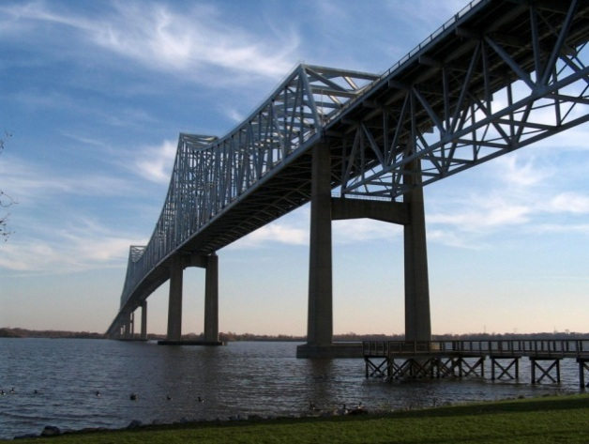
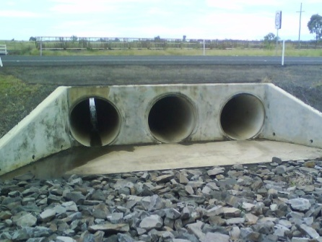
Support for All Infrastructure Types
Software actively used on over 60 types of assets from the most complex to very simple. Examples:
Bridges
Tunnels
Parking Garages
Sign Structures
Culverts
Retaining Walls
Track
Stations
Buildings
Sound Walls
High Mast Lights
Guardrail

Slide 8
Full Support of MAP-21 Requirements
Bridge Management System that is:
Risk based
Data Driven
Performance measures
Supports National Bridge and Tunnel Elements

Slide 9
From Hundreds of Pages like this…

Slide 10
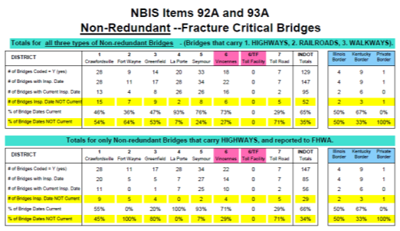
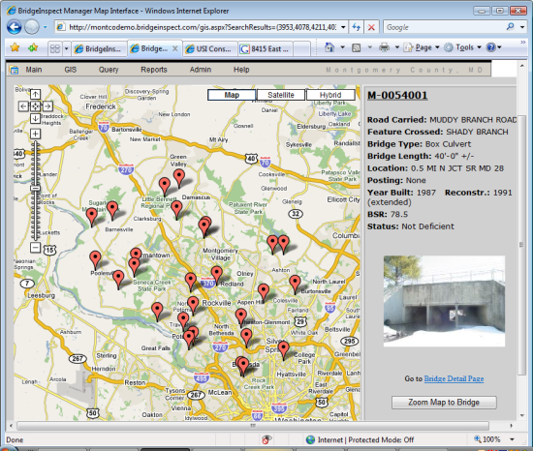
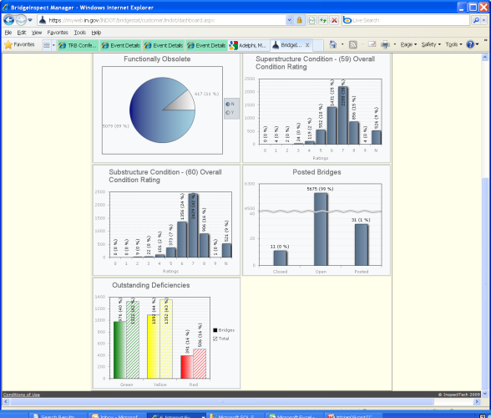
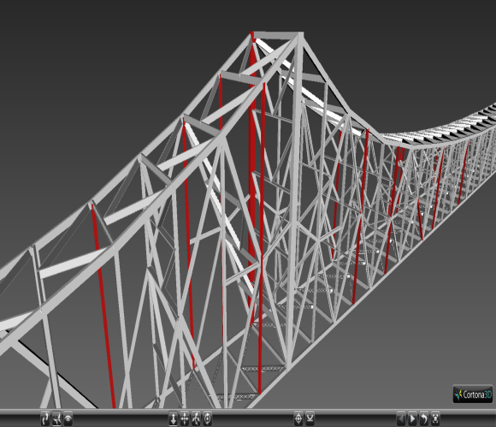
…To A Comprehensive Bridge Inspection & Management System
All asset data in a single online location with easy to use and powerful modules for past, current, and future management.
Prioritization
Scheduling
Pictures/Sketches
GIS
Reporting/Searching
Instant Access
Cost Estimates

Slide 11
InspectTech Representative Users
Federal:
U.S. Navy/Marine Corps
U.S. Fish and Wildlife Service
State:
New Jersey DOT
Ohio DOT
West Virginia DOT
Nevada DOT
Minnesota DOT
Transit:
Washington Metropolitan Transit Authority (DC Metro)
Utah Transit Authority

Slide 12
InspectTech Representative Users
Consulting Firms
AECOM
HDR Engineering Inc.
Beam Longest & Neff
Infrastructure Engineers Inc.
Pennoni Associates Inc.
United Consulting Engineers

Slide 13
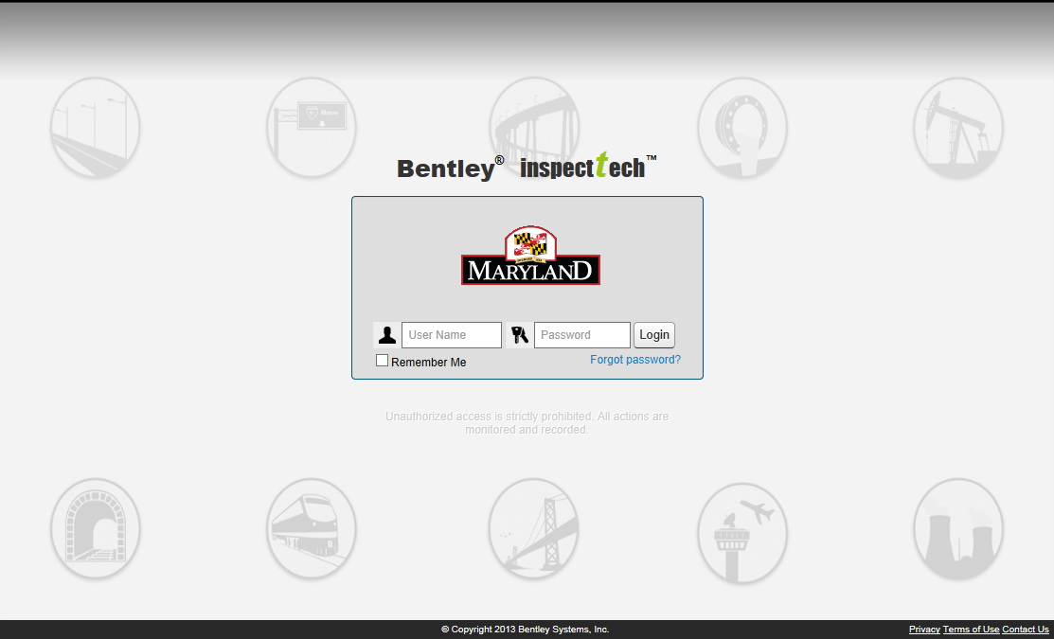
InspectTech Basics
Web Based Interface – Accessible anywhere
Comprised of Collector, Manager, and Maintenance Modules

Slide 14
InspectTech Collector

Slide 15
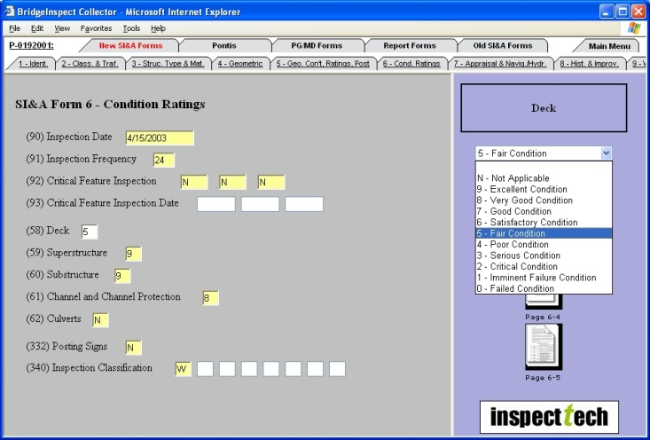
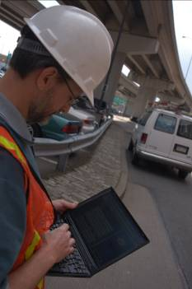
InspectTech Collector
High quality inspections done easier,
quicker, and more reliably!

Slide 16
Full Asset Inventory
Able to store and organize all assets in a detailed hierarchy
Inventory and construction data can be linked directly to the asset
Permissions can be assigned to users by asset and/or specific actions and tasks
Assets can be sub-divided and grouped in multiple ways supporting the various ways business is done

Slide 17
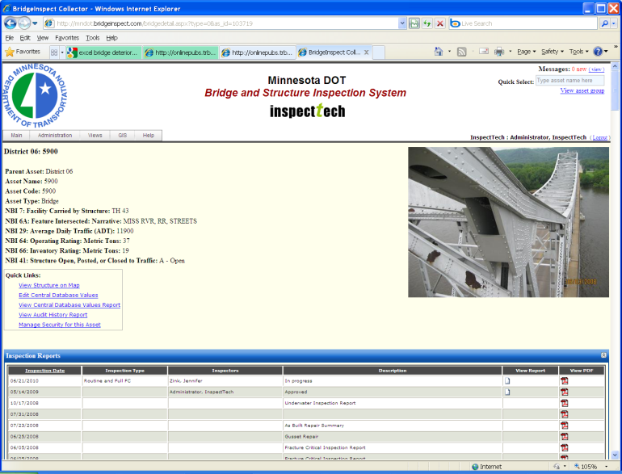
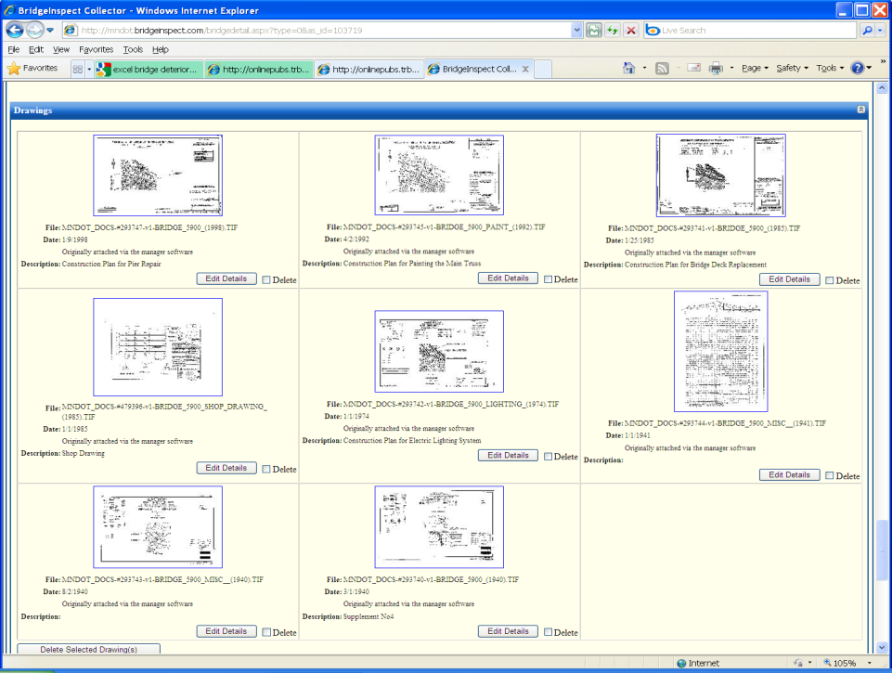
Asset Inventory
Each asset has its own page with links to all key information
Current and historic information is available

Slide 18
Bridge Detail Page
Contains links to all current and past information on the bridge
Reports, Pictures, Sketches, Maintenance Items
Contracts, Load Rating, Letters, etc.
Link to Bridge Location
Bridge Notes
Upcoming inspection dates
Functionality integrated from other programs
Users can control default view

Slide 19
Collector Major Benefits
Electronic collection: Reduces errors and eliminates redundant data entry
Saves significant time by formatting the report and auto-generating many sections:
Table of Contents
Cover Page
Picture Pages
Page Numbering
Picture Organization
Integration of Manuals
Easy incorporation of attachments
Automatically pre-load past data
Notes:
19

Slide 20
Forms Interface
Color coded fields for guiding inspector
Drop-down lists for accuracy
Relevant information shown for each field selected
Full history of how field rated in the past and reference material available
Ability to link photos, videos, and other files directly to a rating

Slide 21
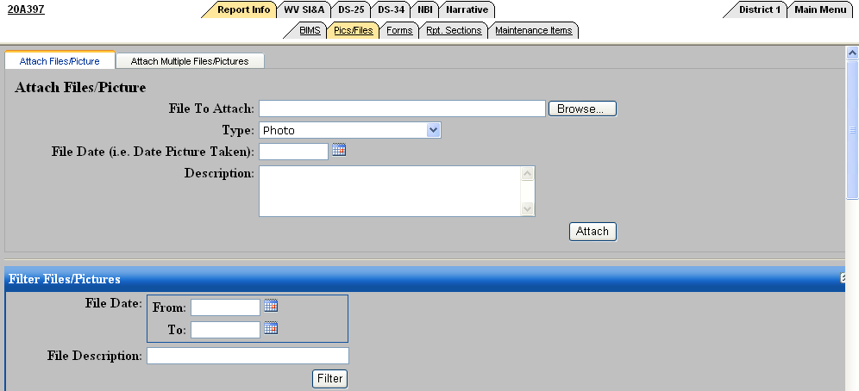
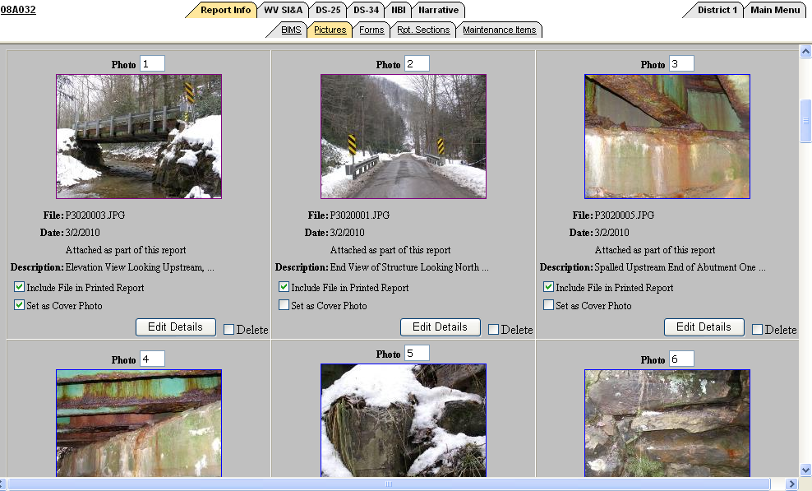
Pictures/Attachments Easy To Add
Can be directly linked to the asset and to the specific area or form field

Slide 22
Reference Material Linked to Each Field
All of the reference materials inspectors use to determine ratings can be linked directly in the software
Exact pages or notes linked directly to the relevant field
Improves accuracy of data entered and time spent

Slide 23
Instant Calculations Based on Data Entered

Slide 24
Simple Inspection Report Generation

Slide 25
Report Review/Approval
Reports have full lifecycle and accountability
Clearly documented who did the inspection
What changes were made
Who reviewed and when
Ability to set approval chain based on bridge
Information not entered into official database until it is approved
Auto-flag certain bridges for review

Slide 26
InspectTech Manager

Slide 27
Manager Capabilities
Full Search Capabilities
Dashboards
Track/Highlight Changes
Accountability of all data entered/changed
Instant Data Access: All digitized documents can be stored and retrieved, such as
Pictures
Diagrams
Memos
Interactive Maps
Triggers/Alerts
Sufficiency Rating calculators/reporting
Do not lose critical knowledge when people retire

Slide 28
Searching/Query
Search across any field within the inspection reports or inventory information
Fields automatically linked from inspection forms to search pages
Boolean logic can create simple or very complex nested queries
Show on screen in table
Export to Excel
Plot results onto interactive map
Very easy to do, no additional programs required.

Slide 29
Query Access

Slide 30
Query Results
Queries can be saved for later use
Organized by user and category
Can be retrieved and edited in Excel
Columns can be showed as values or definitions
Additional non-queried columns can be easily added

Slide 31
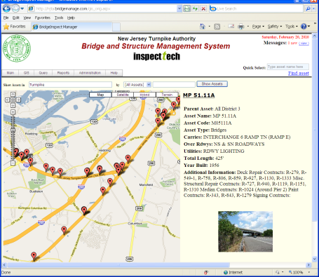
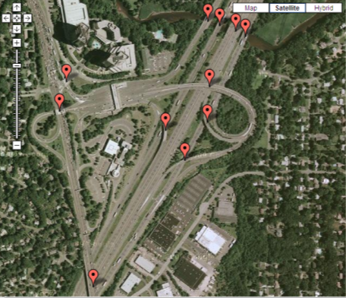
Interactive Mapping

Slide 32
Satellite and Interactive Street Views

Slide 33
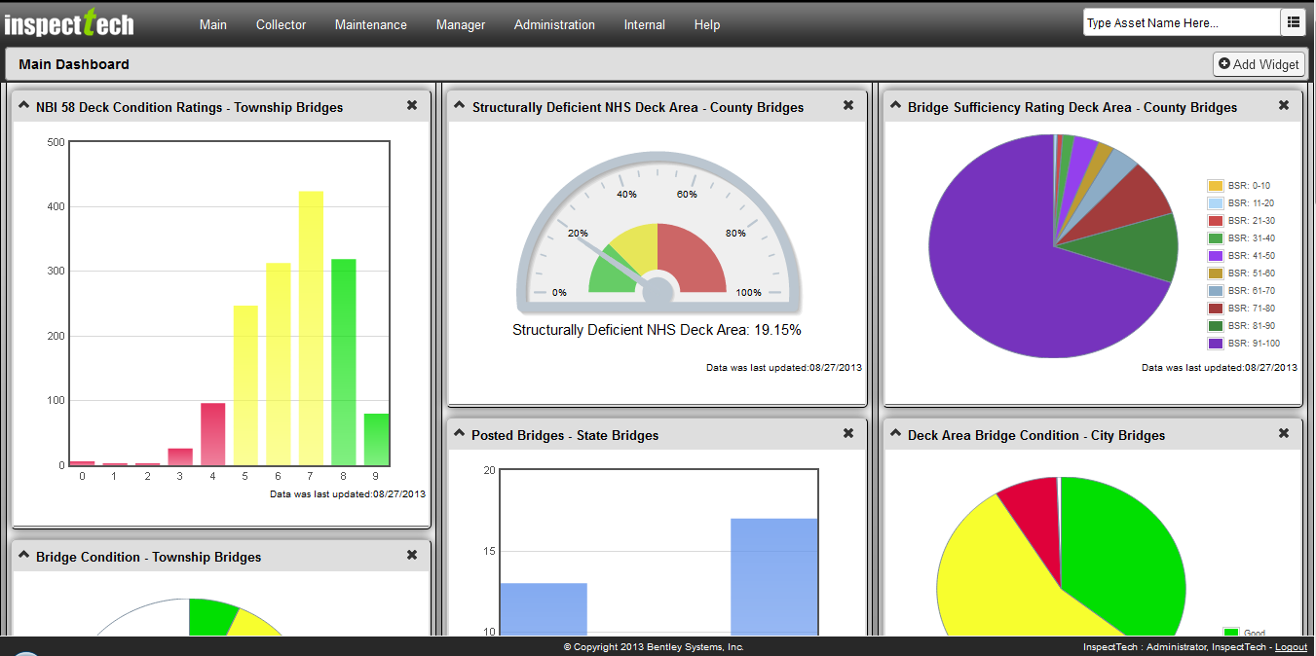
Performance Metric Dashboards

Slide 34
Full Auditing

Slide 35
Audit Details

Slide 36
InspectTech Maintenance

Slide 37
Maintenance Needs/Work Orders
Full support for maintenance needs and work orders
Able to create in the field with an inspection and directly link pictures and videos and inspection narrative
Full tracking and assignment of needs
Support for unit costs or engineer’s judgment
Ablity to assign priorities and group needs by type or asset proximity

Slide 38
Integrated Maintenance Screens

Slide 39
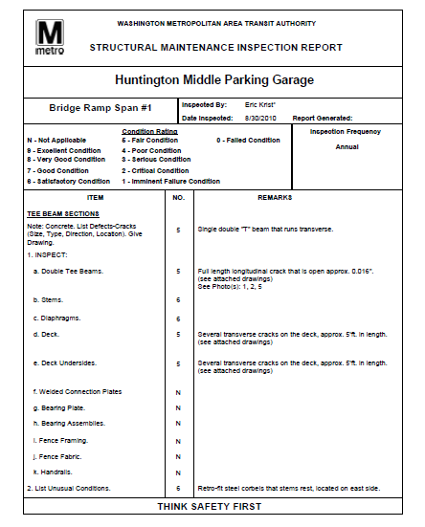
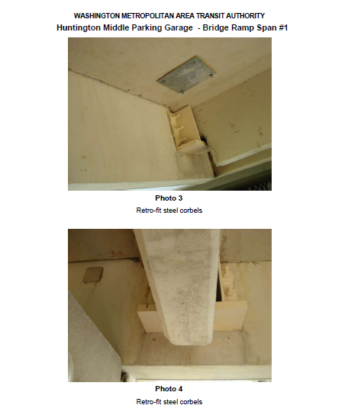
Maintenance Assignments and Tracking

Slide 40
InspectTech Use in Maryland
All Counties utilizing InspectTech for inspection data collection
No More Access Files sent to SHA
InspectTech Version 7 coming soon
Updated user interface utilizing latest technologies
User dashboards and filters
Online Training will be available for both inspectors and managers
New contract negotiations being finalized

Slide 41
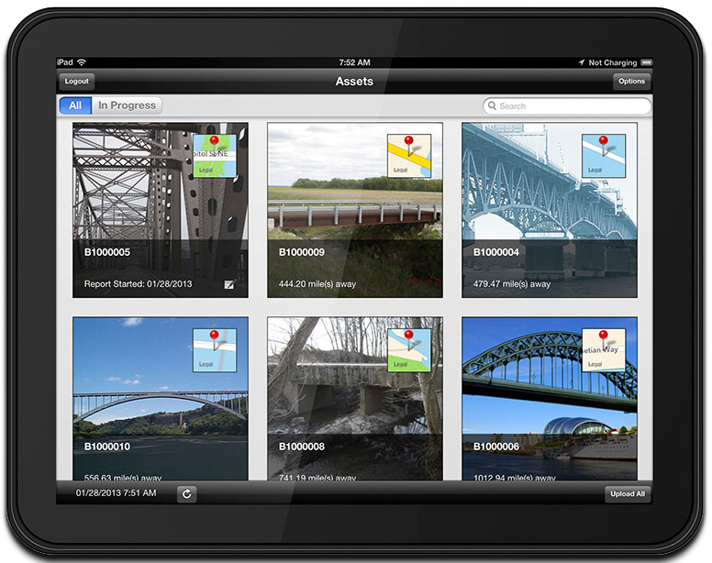
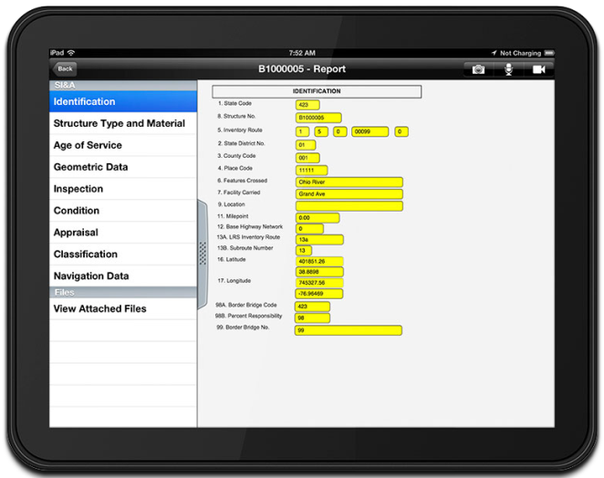
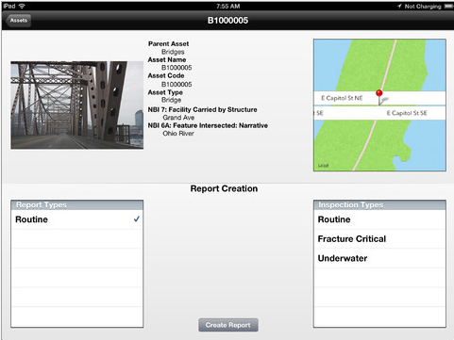
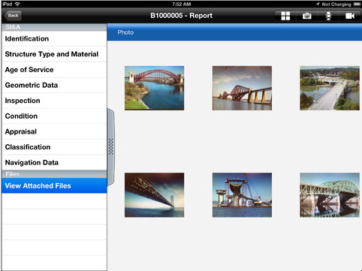
InspectTech Collector Mobile
Field data collection using tablets
Pictures automatically attached

Slide 42
Full Support of MAP-21 Requirements
Bridge Management System that is:
Risk based
Data Driven
Performance measures
Supports National Bridge and Tunnel Elements

Slide 43
Basic Site Overview

Slide 44
Site Login

Slide 45
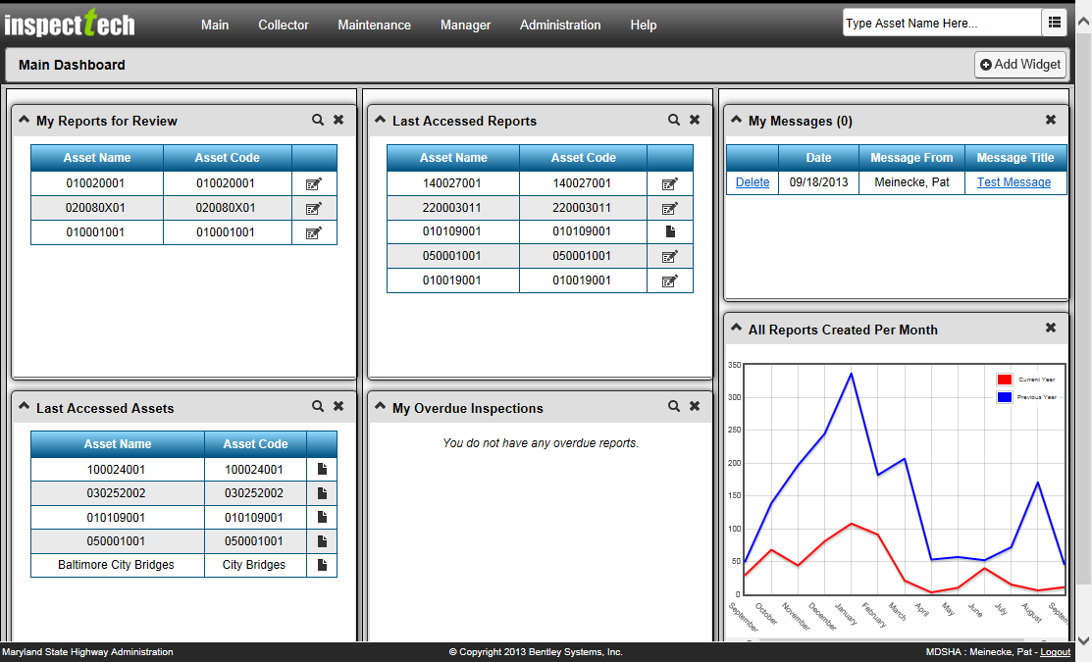
Dashboard

Slide 46
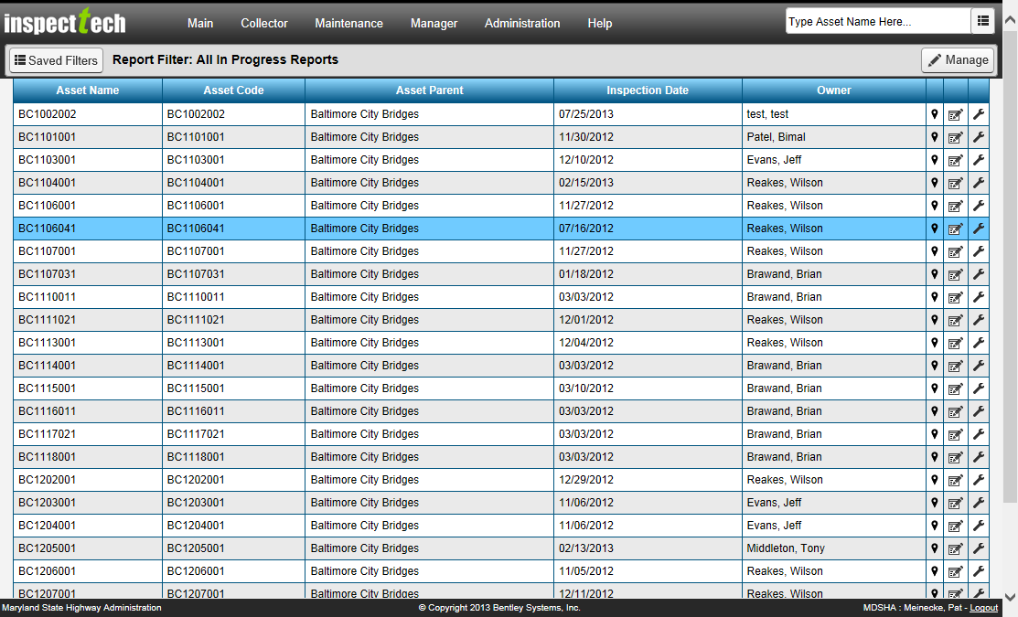
Report Filter

Slide 47
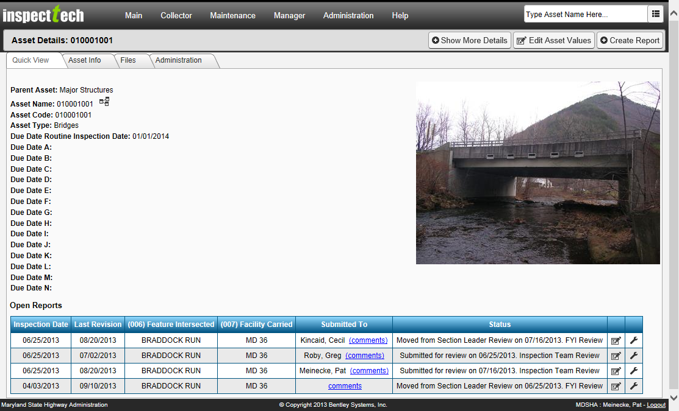
Asset Detail Page

Slide 48
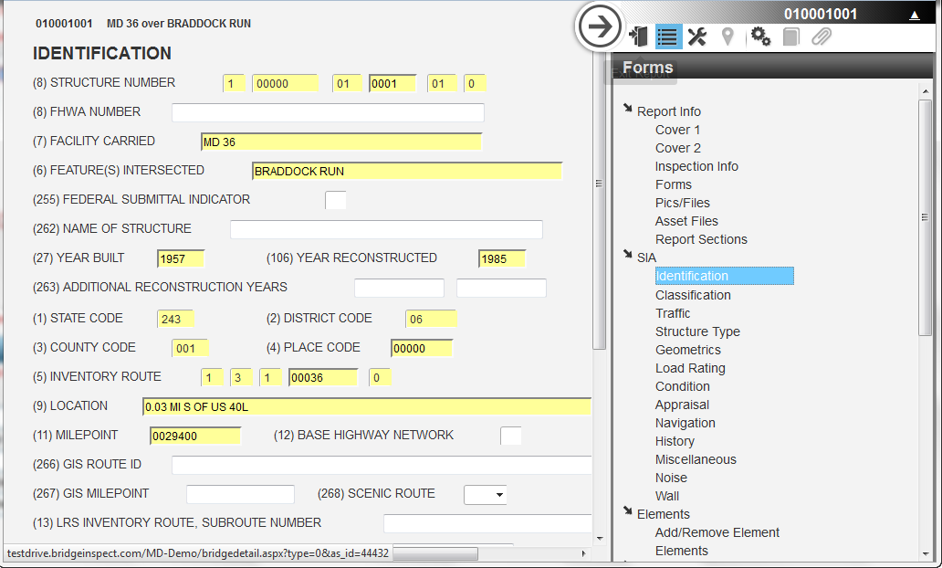
Report Data Entry

Slide 49
Final Thoughts
All Counties now able to benefit
Electronic data collection
Instant report submission
Single source of truth data repository
InspectTech continues to lead Maryland into the 21st century of transportation asset management

Slide 50
Thank You!
Taylor.Gilmore@Bentley.com

