Slide 1
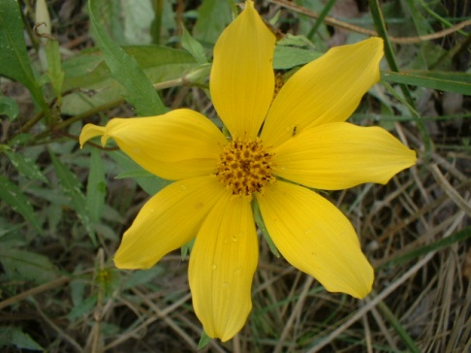
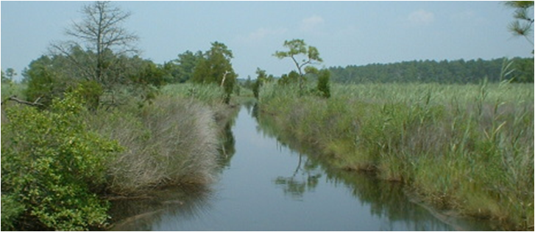
Presentation to: CEAM 2013 Streamlining Environmental Compliance for Major Infrastructure Projects
September 19, 2013

Slide 2
Environmental Impacts & Compliance
Best practices for environmental compliance for major infrastructure projects
Planning phase, design phase and construction phase.
Setting projects up for success.

Slide 3
Introduction
Major infrastructure projects often necessitate unavoidable impacts to sensitive resources
wetlands, waterways, forests
Early assessment of resources, and understanding of regulatory requirements reduces permit approval time and unexpected requirements

Slide 4
Introduction
Discuss best practices for incorporating environmental compliance into design, permitting, construction
Example of best practices implemented on I-95 Express Toll LanesSM project
Traditional permitting approach vs. streamlined approach using best practices

Slide 5
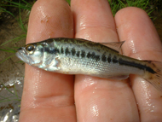
Permitting Approaches
Traditional Approach
Submit at SF or Final Design
Permit issued at back end of design, right before construction
Streamlined Approach Utilizing Best Practices
Submit at Concept Design
Permit issued around SF or Final Design
Special conditions incorporated into final design
Implemented on I-95 Express Toll Lanes, Intercounty Connector (MD 200), and other major infrastructure projects
Notes:
5

Slide 6
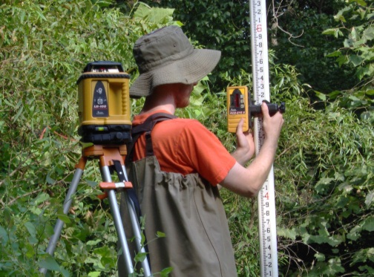
Pitfalls/Disadvantages of Traditional Approach
Regulatory agencies typically not involved until application submitted
Review → permit issuance
9 – 12 months
Back end of design
Agency feedback may require design revisions late in the game, further impacting schedule and budget.
Agencies are not “part” of the design process, not fostering teaming and trust

Slide 7
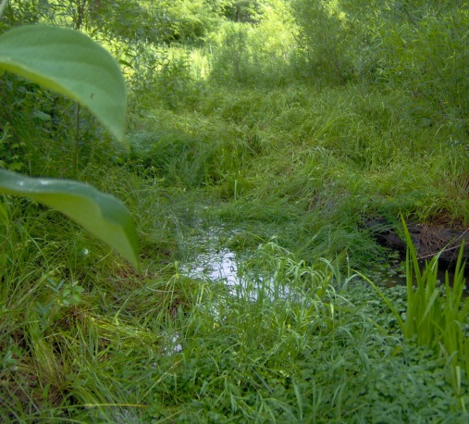
Pitfalls/Disadvantages of Traditional Approach
Holds up construction on major projects with
with multiple contracts/task orders with different schedules
Permit application held up until all contracts/task orders reach permittable stage (e.g., SF or Final Design)
Construction cannot begin until permits covering entire project area are issued
Cannot permit individual contracts/task orders separately

Slide 8
Best Practices For Environmental Compliance

Slide 9
Best Practices
Know your client and previous agreements
MOAs, MOUs, exemptions under regulations
Don’t rely on regulators to identify these
Know the regulations and requirements for permit
Understand documentation required – get it right the first time!
COMAR is a great resource
When in doubt, contact the agencies – they’re there to help!
Identify environmental resources at planning stage
Plan study areas conservatively
Reduce need for additional studies as design progresses

Slide 10
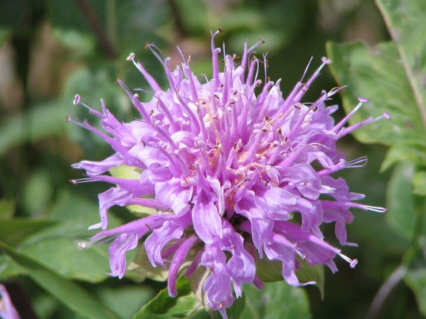
Best Practices
Include Avoidance & Minimization in design
Reduce impacts to only those unavoidable
More impacts = More regulatory review/permitting = More money and time
Like infrastructure, water resources are assets
Avoiding/minimizing impacts saves money (no/less mitigation)
Provide ecological, recreational, aesthetic value

Slide 11
Best Practices
Communication, Teaming, Build Trust
Involve the agencies early and often
Include them in the process and be transparent
Don’t stockpile information
Communicate your needs, schedules, etc.
Be willing to identify potential problems/concerns and ask questions
Cultivate them as partners, not adversaries
Building trust reduces review times and improves flexibility

Slide 12
Best Practices
Team with the agencies
Use agencies as a resource to help navigate permitting environment
Agencies want project to be successful and go smoothly
Especially infrastructure projects improving public health and safety
Realize agencies’ agendas are different from, but not necessarily opposed, to yours
Successful and smooth-running projects = less work for the agencies, who are already overloaded

Slide 13
Best Practices
Submit permit at Concept Design based on
worst case scenario of impacts for LEDPA
Complete resource assessments during planning stage
Begins permitting process early and concurrent with design
Permits issued with conditions to continue avoidance & minimization during design, including possible design requirements
Agencies are “part” of the design process
Review designs for compliance
Work with applicant to resolve issues during design
Final designs with agency approval move straight to procurement and construction, rather than waiting for permitting process
Notes:
13

Slide 14
Best Practices
Pursue project-wide permit for major projects
with multiple contracts/task orders
One public notice
Construction of early contracts/task orders doesn’t have to wait for later contracts
Transparency and communication of changes to impacts during final design and construction
Unavoidable increases to permitted impacts will very likely occur during final design – agencies need to accept “fact of life”
Flag these to agencies when submitting plans, include justification
Involve agencies in discussions of field mods increasing impacts
Report design and construction impacts on regular basis (e.g., quarterly)

Slide 15
Best Practices
Establish an Environmental Lead
Lead design reviews for compliance
Track and report compliance with permits and conditions
Serve as single point-of-contact with agencies
Establish an Environmental Monitor
Inspect, ensure, and report on environmental compliance during construction
Identify potential compliance issues early, before non-compliance or violation occurs
Team with other inspectors, engineers, and managers to problem-solve issues

Slide 16
I-95 Express Toll LanesSM (ETLs) Project

Slide 17
I-95 ETLs Project - Background
MDTA currently designing and constructing improvements to I-95
Permitted for 10 miles of I-95 from I-95/I-895 North split to ~3 miles north of White Marsh Blvd (MD 43)
Adding general purpose and managed access (Express Toll Lanes) to improve safety and service
Reconstruction of intersections at I-895, I-695, MD 43
Ten individual construction contracts
Planning/NEPA phase, culminating with FONSI in July 2005
Design began shortly after with construction of first contract beginning 2005, tenth and final contract currently in procurement.

Slide 18
I-95 ETLs Project - Background

Slide 19
I-95 ETLs Project - Background

Slide 20
I-95 ETLs Project – Best Practices
Planning and Permitting Phases
Wetlands and Waterways
Wetlands and waterways delineated, JD field visits with USACE completed, during Planning/NEPA phase
USACE involved during Planning/NEPA phase design
Provided input on design/impacts
Other environmental commitments included in FONSI
Permit application and permits issued based on impacts associated with PI design included in FONSI
Both USACE and MDE included Special Conditions for design, construction, and post-construction

Slide 21
I-95 ETLs Project – Best Practices
Planning and Permitting Phases
Forests
Project subject to Reforestation Law
Requires 1:1, acre for acre mitigation
Accounts for forests and individual trees
Reforestation credit granted for forests and individual trees
Reforestation needs to be in ground 1 year or 2 growing seasons after project completion
No project-wide approval
DNR preferred to review and permit impacts contract by contract
Forest stands delineated during Planning/NEPA phase
Notes:
21

Slide 22
I-95 ETLs Project – Best Practices
Detailed Design Phase
Environmental Lead established
Review designs for compliance
Manage environmental permits
Track and report compliance with permits, conditions, and commitments
Serve as single point-of-contact with agencies

Slide 23
I-95 ETLs Project – Best Practices
Detailed Design Phase
Wetlands and Waterways
MDTA, Discipline Leads (e.g., Environmental Lead), and agencies performed concurrent reviews
Environmental Lead and Agencies reviewed and commented on compliance and avoidance & minimization
Designer addressed comments during development of subsequent design submittal
After all agency comments addressed, MDE issued approval letter, USACE issued email stating no further comments

Slide 24
I-95 ETLs Project – Best Practices
Detailed Design Phase
Forests
Planting Plans reviewed at each design phase to ensure plantings meet Reforestation Law requirements
Reforestation Law review (application and forest impact plates) submitted based on SF Design
Reforestation/Planting Plans submitted 90 days prior to Advertisement
Approval for each contract issued prior to Advertisement
Off-site mitigation search conducted and several sites selected

Slide 25
I-95 ETLs Project – Best Practices
Detailed Design Phase
Communication with Agencies
Environmental Lead flagged any increase in impacts to individual resources and provided justification to agencies
Agreement made to avoid multiple permit modifications
Agency approval letter/email of final design plans authorized all increases to individual resources above permitted level
One permit modification at end of design will align permit with final design impacts
Agencies involved throughout entire detailed design
Quarterly impact updates
Quarterly meetings
Regular emails, phone calls, other ad-hoc meetings
Notes:
25

Slide 26
I-95 ETLs Project – Best Practices
Construction Phase
Wetlands and Waterways
Agencies part of redline review process
MDTA provides Environmental Construction staff
Per permit conditions, MDTA funds Independent Environmental Monitor
All construction staff, inspectors, and IEM work together to identify problems early and resolve issues
Quarterly meetings
Feedback re: construction issues in field during early contracts informed design for later contracts
Environmental Construction Inspectors prepare daily reports. IEM prepares daily and monthly reports

Slide 27
I-95 ETLs Project – Best Practices
Construction Phase
Forests
If impacts changed due to redlines, then new Reforestation Law approval was issued by DNR
Reforestation visited after installation and again at one year post installation
Fee-in-lieu payment accepted to mitigate for remainder of required reforestation after on-site and off-site planting was maximized and documented in a report

Slide 28
Improving Streamlined Approach
Ideas for improving streamlined approach
Based on experience with I-95 ETL Project
Assume all impacts within LOD to be permanent at permit application
Puts worst case scenario on public notice, reducing risk of future public notice
Requires buy-in from agencies
Permanent impacts that may be avoidable/minimized are technically authorized

Slide 29
Improving Streamlined Approach
Ideas for improving streamlined approach
Pay careful attention to wetland and stream delineation efforts
Ensure study areas are large enough to allow for changes in the project limits
Ensure that all necessary information is collected at the beginning (functions and values, wetland and stream types)
Careful tracking and QA of water resources and impacts so there is consistency among various documents (JPA, EA/FONSI, etc.)
Consider beginning the permitting process in parallel with the NEPA efforts
Integrate environmental and engineering functions within the design organization

Slide 30
www.straughanenvironmental.com
Straughan Environmental, Inc.
10245 Old Columbia Road
Columbia, MD 21046
marketing@straughanenvironmental.com • 301-362-9200

